Slide 1
Status Report: Detecting Deepfakes
Kat, Greg, and Laurens • 20.03.2020

Slide 2
A modern challenge: DeepFakes
What are DeepFakes?
Two primary types
15000 DeepFakes online (more than 100% growth from last year)
Threatened areas:
DeepFake pornography (96%)
Politics and Cybersecurity

Slide 3
Goals
Aims for the Capstone
Develop a CNN with better performance on recognition accuracy building FaceForensics++
Relevance
Emerging problems: deepfake pornography, destabilization of politics, enhancement of traditional cyber threats
Protect individuals and organizations from harmful applications
Notes:
Capstone aims:
CNN with better performance
Devise a way to increase the difficulty of the training set
If there is time, lightweight NN (trade off between accuracy and computational complexity)
Problems:
Pornography (affecting almost exclusively females while other videos have a more balanced target, there is also a difference in split by nationality and profession when comparing pornography and other videos)
Destabilization of politics (loss of trust in the objectivity of videos due to growing awareness of deepfakes)
Cybersecurity threats (synthetic photos of non-existent people were used on fake social media profiles, in an attempt to deceive other users and extract information)
Relevance:
Protection from harmful applications because deepfake technology is constantly developed and improved

Slide 4
Status - Extracting the data
Benchmark dataset proposed in FaceForensics++
> 1.8 million manipulated images from 1000 original extracted sequences (from 977 YouTube videos)
Frontal face imagery, without occlusions
Random compression and random dimensions
Manipulated by 4 state of the art methods (including facial expression and identity manipulation):
Deepfakes
Face2Face
FaceSwap
NeuralTextures
Notes:
> 1.8 million images from 1000 extractions from 977 Youtube videos
Random compression and dimensions of images to simulate a more realistic scenario
4 methods:
(identity manipulation)
1. DeepFakes (face replacement based on deep learning)
2. FaceSwap (face replacement from a source video to a target video)
(facial expression manipulation)
3. Face2Face (transfering the expressions of a source video to a target video while maintaining the identity of the target person)
4. NeuralTextures(only modify the facial expressions corresponding to the mouth region)

Slide 5
Status - Loading and preprocessing the data
Loading
Script to load the data into numpy arrays from Google drive
Next steps:
Extract frames in GCP and move to Google drive (due to large size of uncompressed videos)
Preprocessing
Resizing to the same size
Centering and normalisation with ImagedataGenerator class in Keras: (samplewise_center=True, samplewise_std_normalization=True)
Train-time and test-time augmentation tbd
Notes:
NN. Layers extract representations out of the data fed into them. Revolves around layers, input data and respective targets, a loss function and optimiser.
Feature engineering bypassed in 2012, with the breakthrough in the ImageNet competition.
Engineering Science.
Gradient-based optimisation, stochastic gradient descent. Chaining derivatives: the backpropagation algorithm.
CNN: stack of Conv2D and MaxPooling 2D Layers.
The fundamental difference between a densely connected layer and a convolution layer is this: Dense layers learn global patterns in their input feature space (for exam-ple, for a MNIST digit, patterns involving all pixels), whereas convolution layers learn local patterns (see figure 5.1). 99.3% accuracy.
Translation invariant. Independent of location on image, something can be remembered. Not the case for densely connected layers. Spatial hierarchies.
The depth of the feature maps progressively increases in the network (from 32 to 128), whereas the size of the feature maps decreases (from 148 × 148 to 7 × 7). This is a pattern you’ll see in almost all convnets.

Slide 6
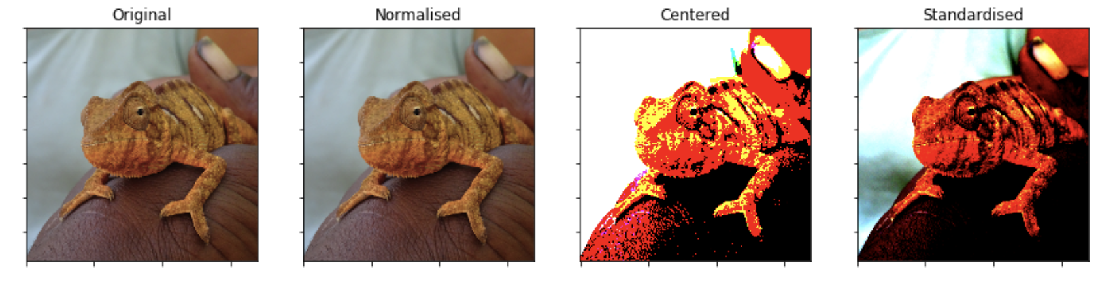
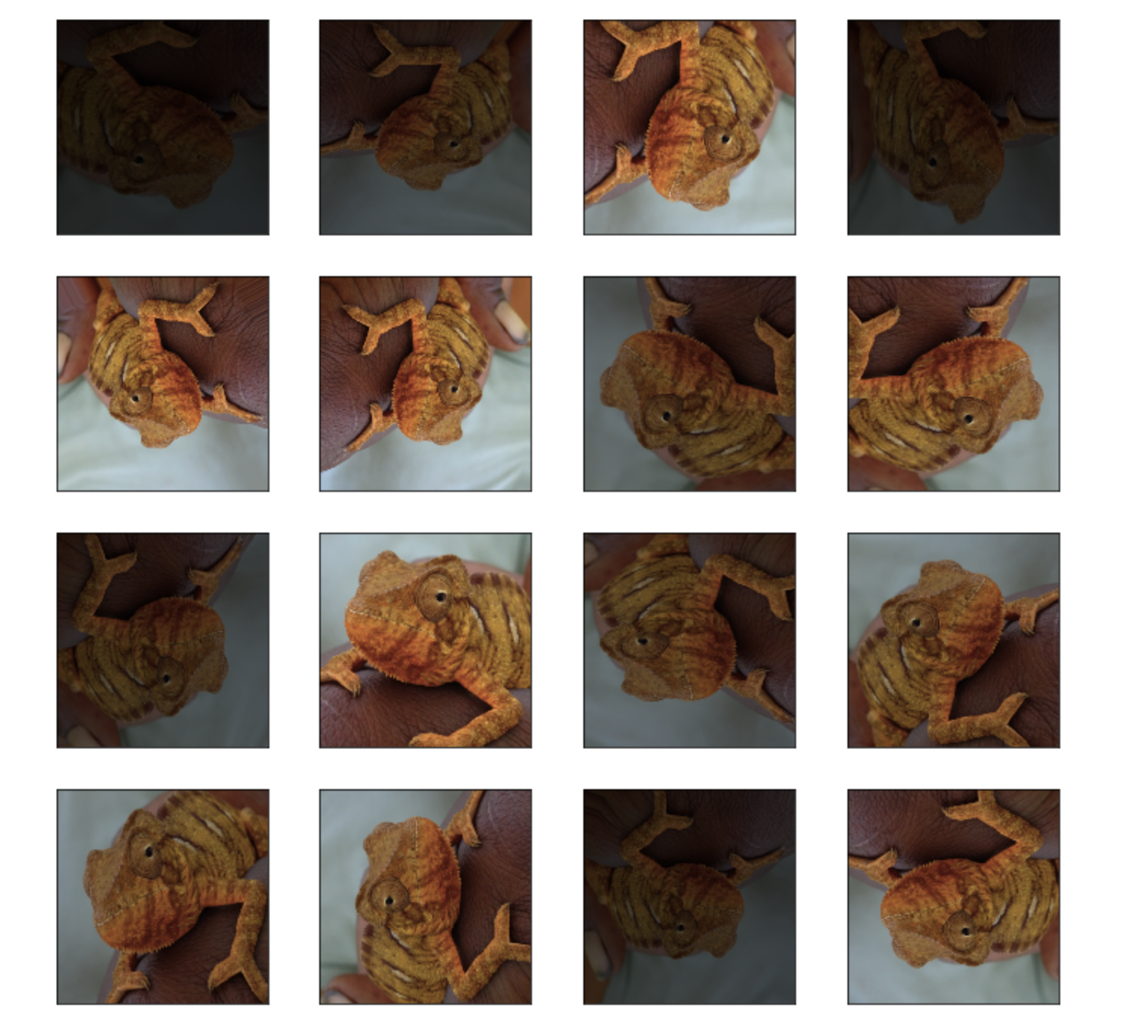
Notes:
Original, IDG(rescale=1.0/255.0), IDG(samplewise_center=True),
IDG(samplewise_center=True, samplewise_std_normalization=True)
horizontal_flip=True, vertical_flip=True,
rotation_range=90, brightness_range=[0.2,1.0], zoom_range=[0.6,1.0])

Slide 7
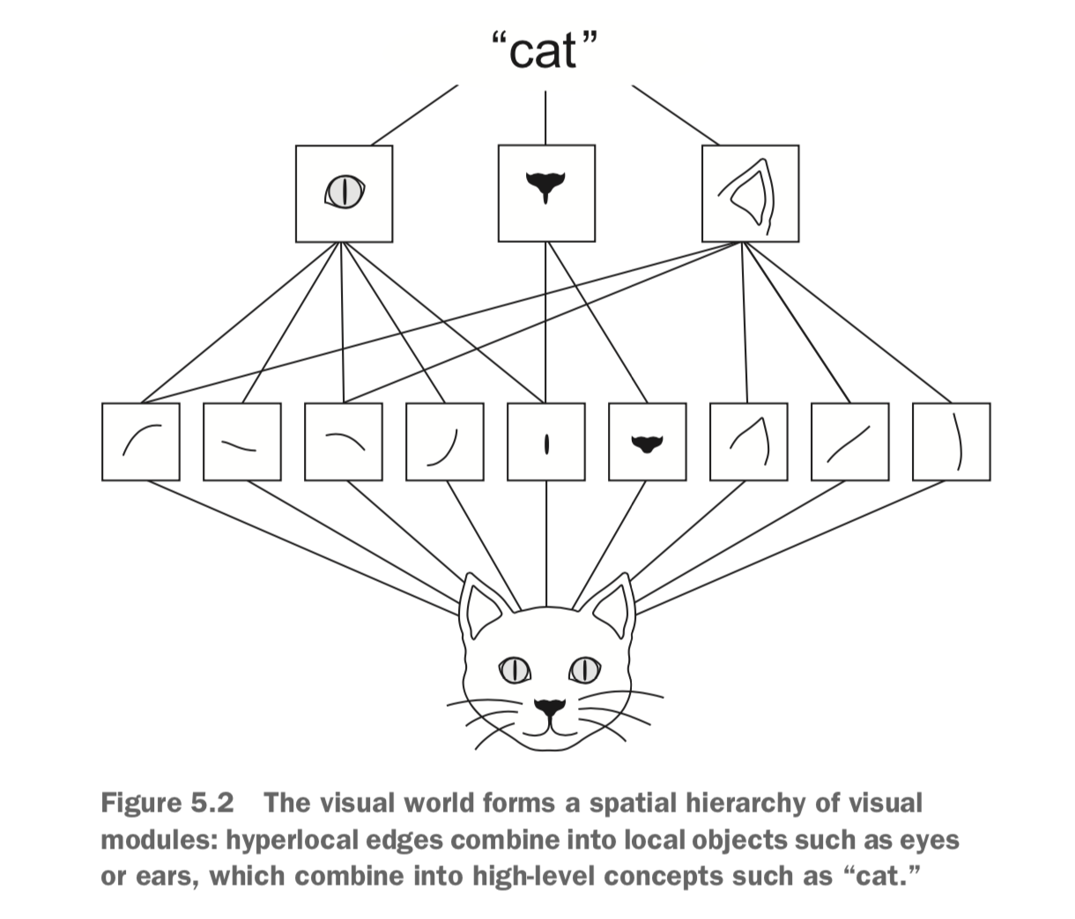
Status - Neural Networks
Exploratory phase
Sequential class and CIFAR
Auxiliary functions in place - visualising training process, storing weights, automating augmentation
Feature extraction and fine-tuning attempts made
Architecture findings
VGG is outdated
Fine-tuning of ResNet: Exploding gradients problem
Potential solution: Train ResNet from scratch - expensive
Data augmentation is essential
Notes:
Paper examines the realism of state-of-the-art image manipulations. Propose an automated benchmark for facial manipulation detection. The dataset is an order of magnitude larger than comparable, publicly available, forgery datasets. The use of additional domain-specific knowledge improves forgery detection to unprecedented accuracy, even in the presence of a strong compression. Deepfakes are created using Deep Learning (Generative Adversarial Nets). The paper can automatically and reliably detect such manipulations, and outperforms humans by a significant margin. Most techniques suffer from low image resolutions. Recently, this has been improved by using progressive growing of GANs, producing high-quality synthesis of faces.
Multimedia forensics: this aims to ensure authenticity, origin and provenance of an image or video without the help of an embedded security scheme. Recent literature concentrates on CNN-based solutions, both through supervised and unsupervised learning.
Description architectures: Five network architectures were evaluated. XceptionNet is a traditional CNN trained on ImageNet based on separable convolutions with residual connections. Transferred to their task by replacing the final fully connected layer with two outputs.
Photos are manipulated using Face2Face, FaceSwap, DeepFakes, and NeuralTextures. two graphics based approaches (Face2Face and FaceSwap) and two learning-based approaches (DeepFakes and NeuralTextures)
Challenge: The experiments show that all detection approaches achieve a lower accuracy on the GAN-based NeuralTextures approach. NeuralTextures trains a unique model for every manipulation which results in a higher variation of possible artifacts. Training corpus size plays an important role in testMSE. Different ways of creating deepfakes.

Slide 8
Next steps

Slide 9
Next steps
Use case: Applications on phones, FaceID security
Tensorflow Lite
Moving from the sequential class to the functional API
Experimenting with parameters and different ways of augmenting the data
Exploring integrating RNNs

